Slide 1
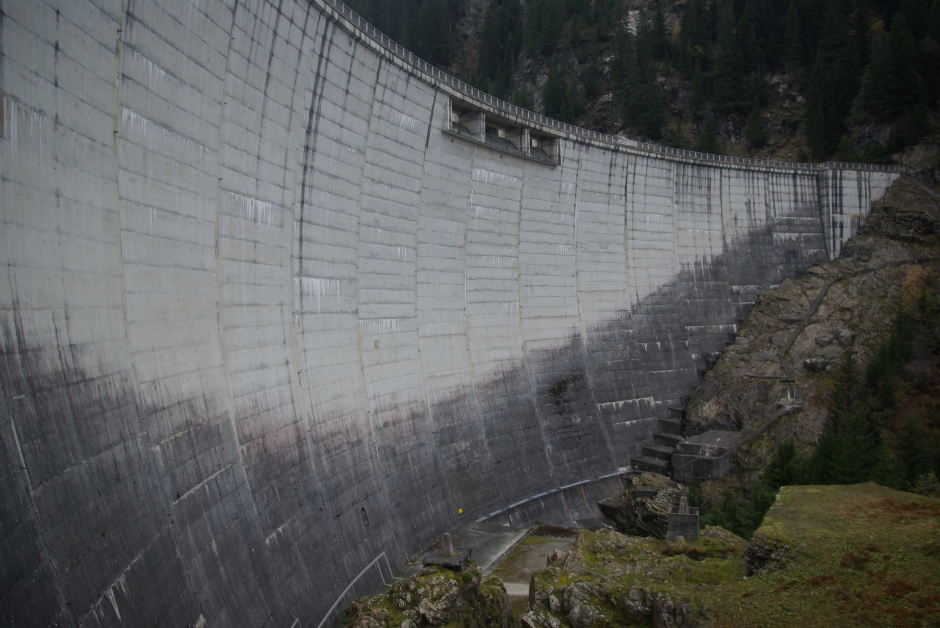
Spatial variability of the seismic ground motion on the dam - foundation rock interface
F. Dufour, E. Koufoudi, E. Chaljub, N. Humbert, E. Robbe, E. Bourdarot
Saint-Malo © Yannick LE GAL

Slide 2
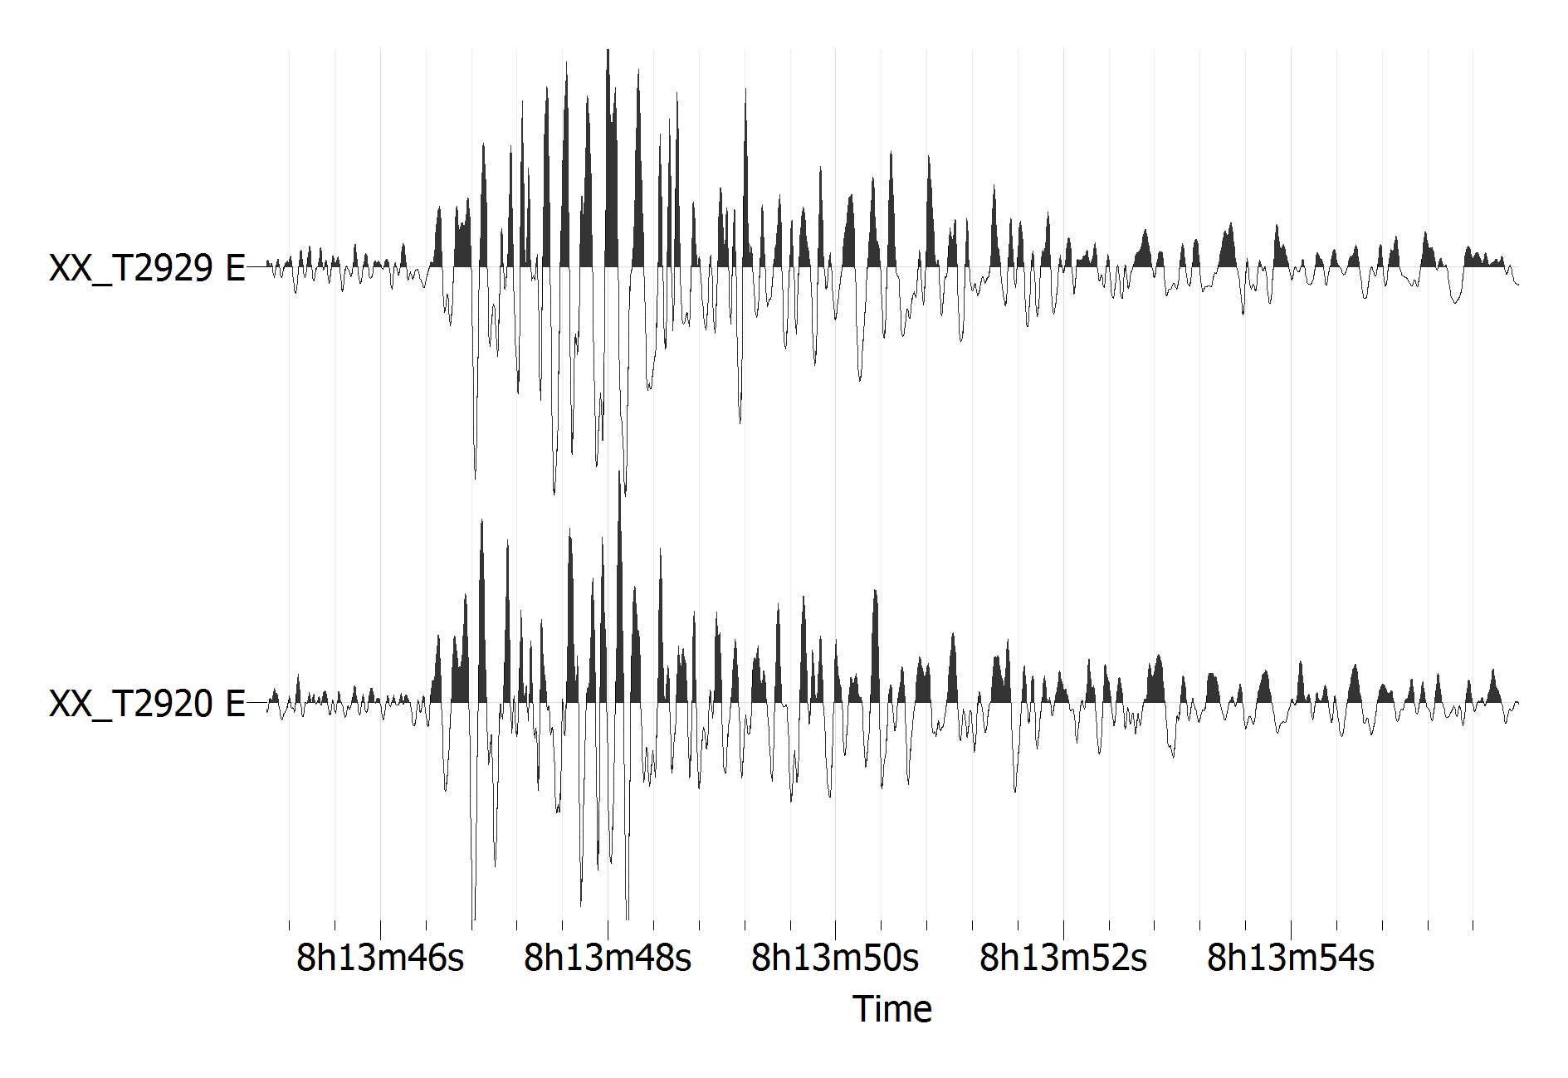
Spatial variability of the seismic ground motion
Engineered Structure
Differences between 2 time series :
Amplitude
Phase content
Surface
Fault
Seismic waves
Source
Spatial variability of the seismic ground motion on the dam foundation rock interface | 2016
2

Slide 3
OUTLINE
Experimental study in Saint-Guérin site
Spatial variability analysis
Numerical modelling
Conclusions - Perspectives
3

Slide 4
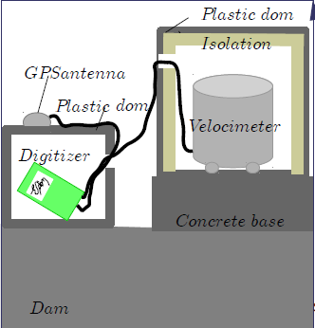
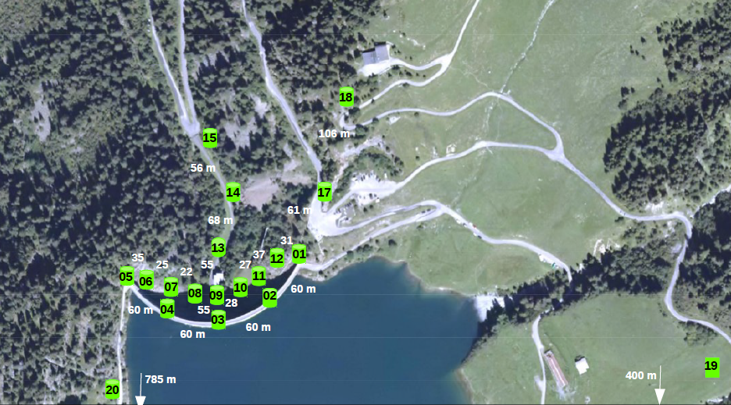
Configuration of the seismological array
4

Slide 5
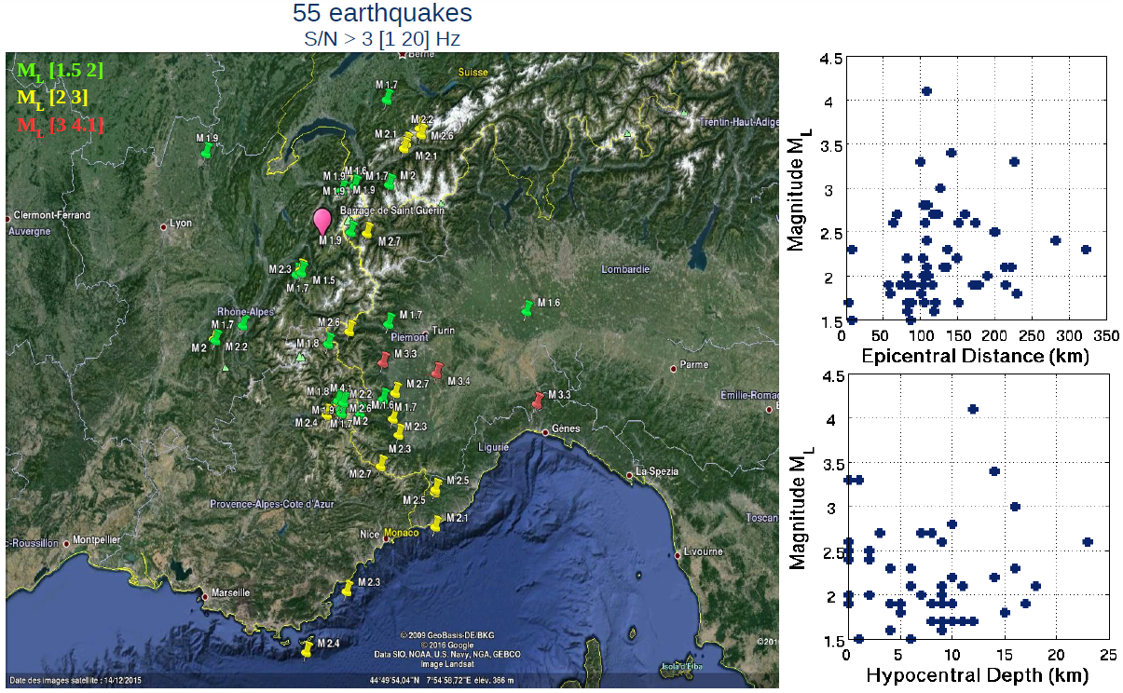
Earthquake records
5

Slide 6
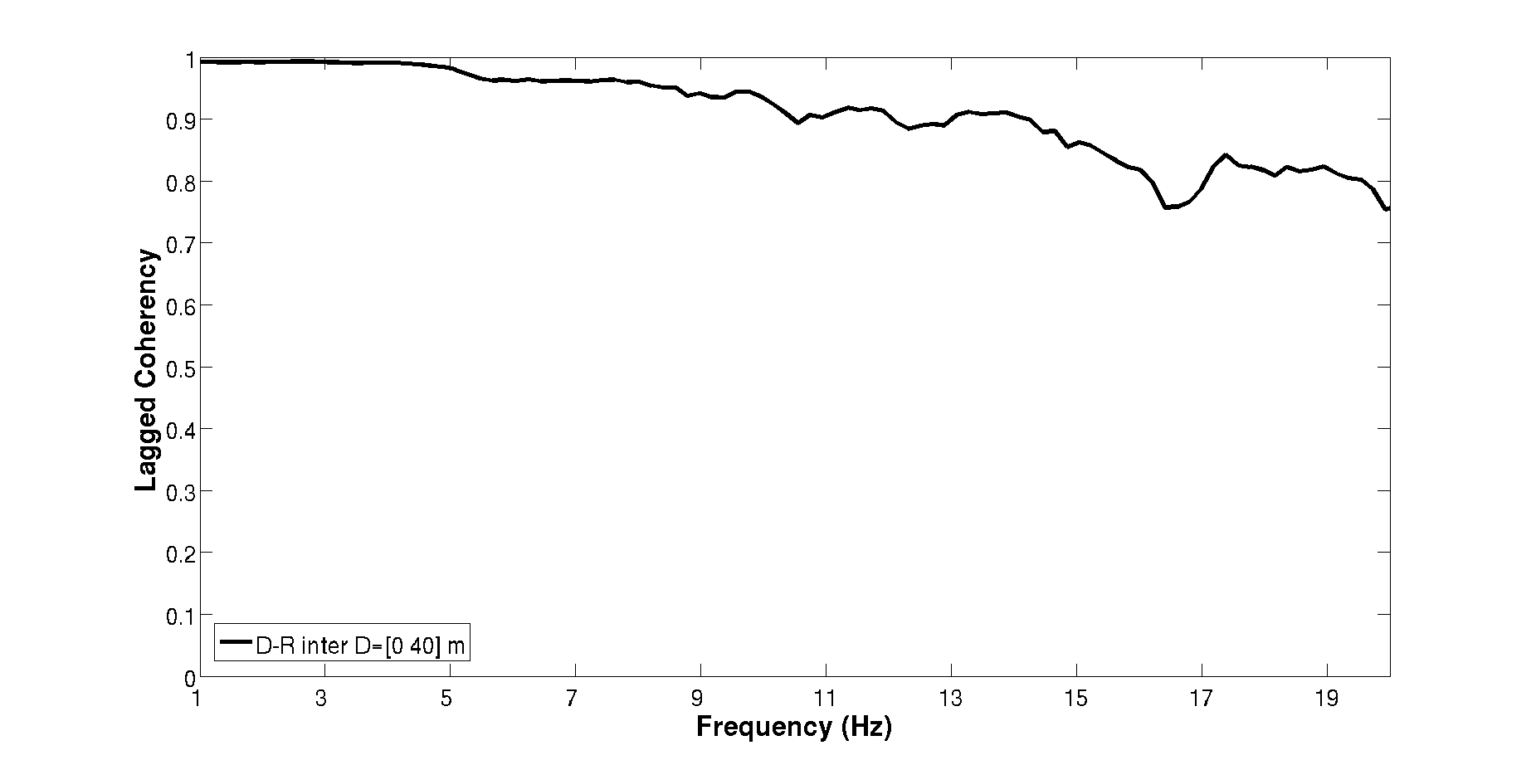
S
Phase Variability
SG18
Lagged Coherency
SG17
SG01
SG02
SG03
SG04
SG05
SG12
SG06
SG11
SG09
SG07
SG10
SG08
NS component
SG13
SG14
SG15
N
6

Slide 7
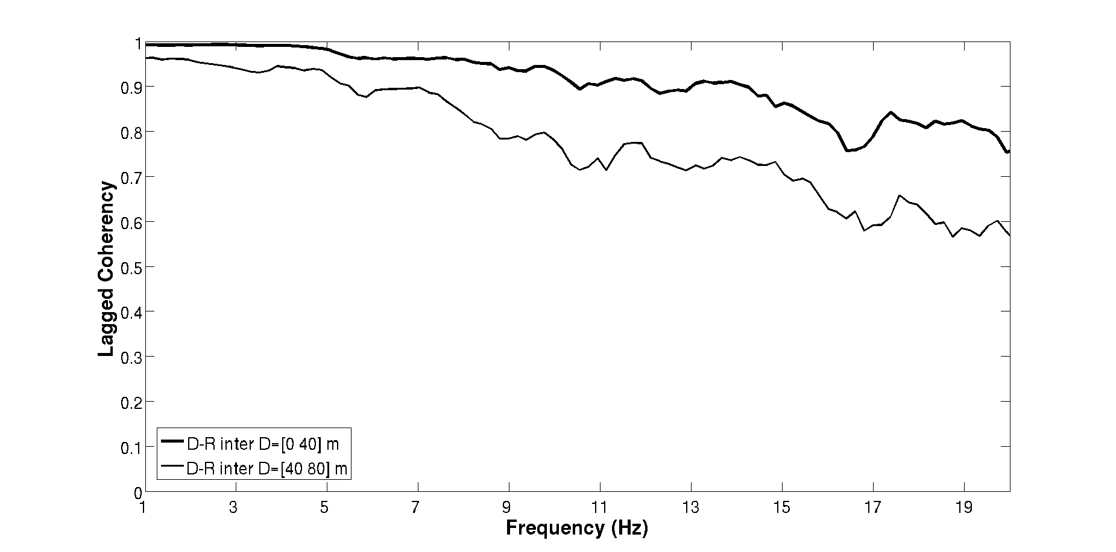
S
Phase Variability
SG18
Lagged Coherency
SG17
SG01
SG02
SG03
SG04
SG05
SG12
SG06
SG11
SG09
SG07
SG10
SG08
NS component
SG13
SG14
SG15
N
7

Slide 8
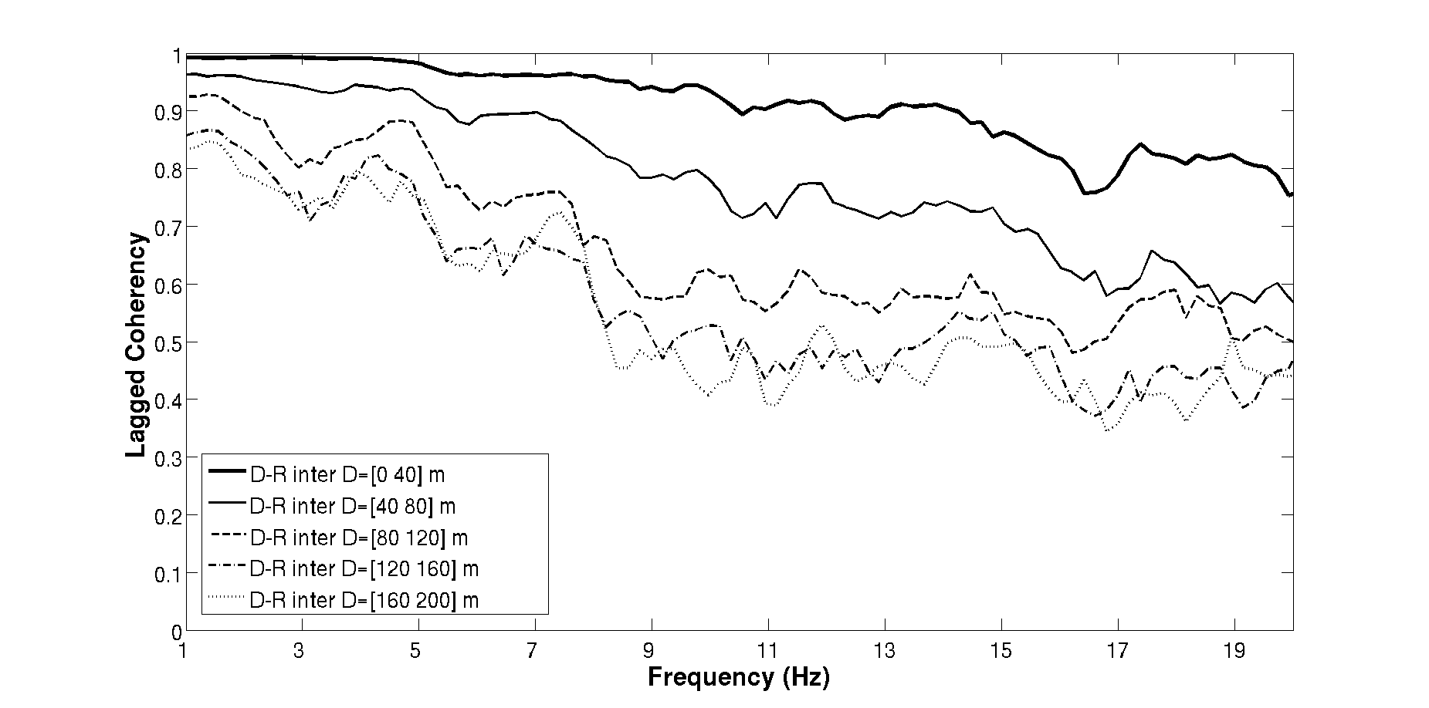
S
Phase Variability
SG18
Lagged Coherency
SG17
SG01
SG02
SG03
SG04
SG05
SG12
SG06
SG11
SG09
SG07
SG10
SG08
NS component
SG13
SG14
SG15
N
No dependency on source parameters :
- magnitude
- distance
- azimuth
8

Slide 9
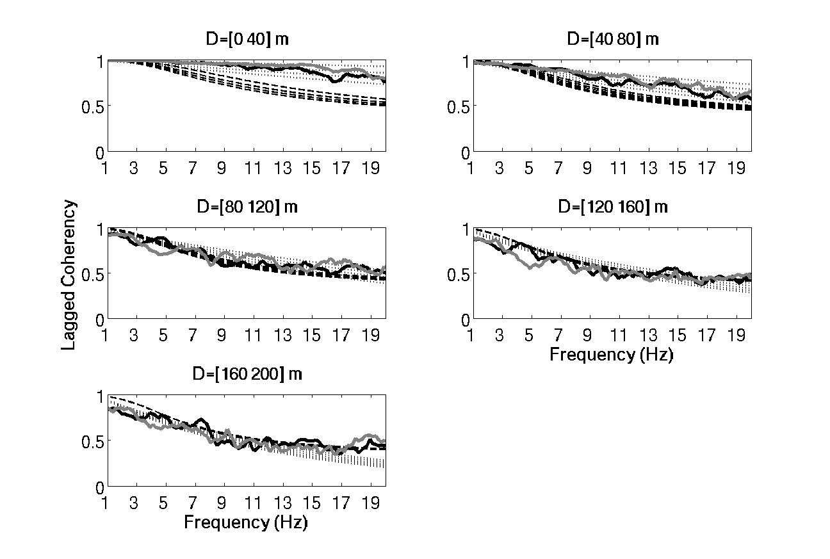
Comparison with existing coherency models
Saint Guérin NS
Saint-Guérin EW
Abrahamson 1993
Menke et al. 1990
9
Good fit between in-situ measures and models ⇒ local site effects are secondary ?

Slide 10
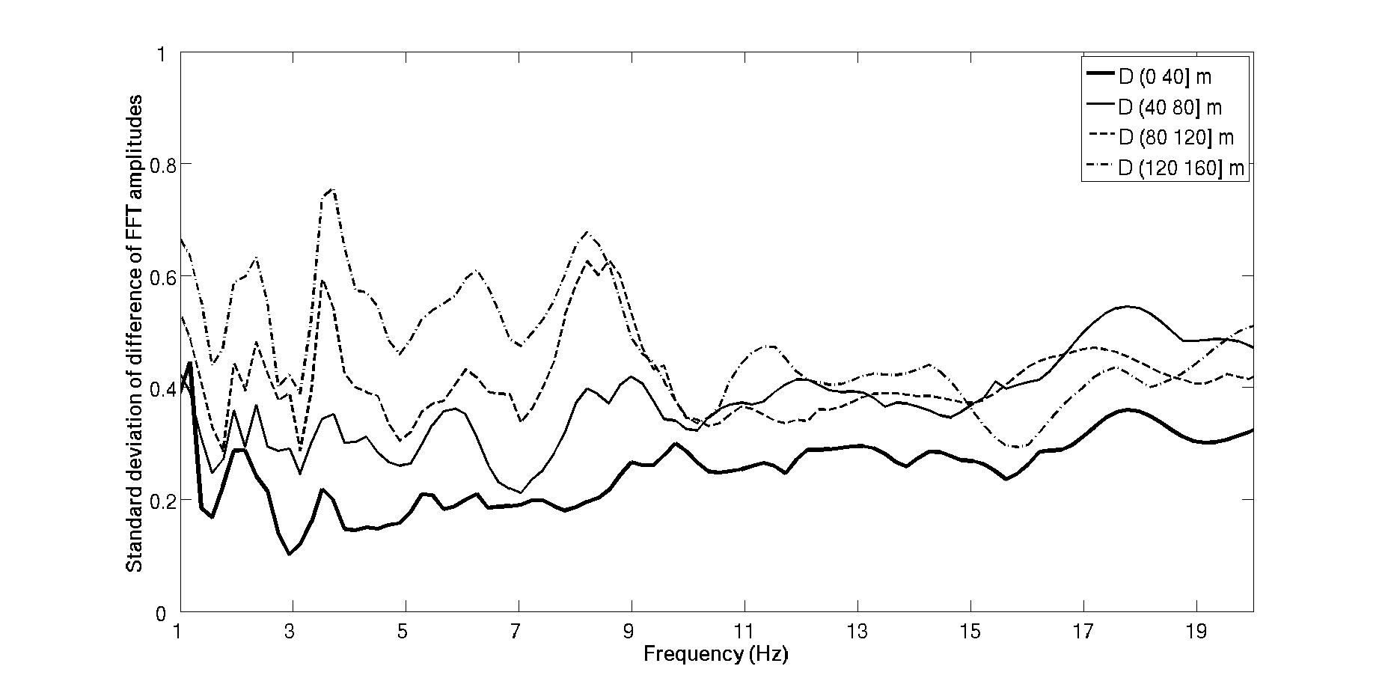
S
Amplitude Variability
SG01
SG02
SG03
SG04
SG05
Standard deviation of difference
of log FFT amplitudes
SG12
SG06
SG11
SG09
SG07
SG10
SG08
NS component
SG13
SG14
SG15
N
No dependency on source parameters :
- magnitude
- distance
- azimuth
10

Slide 11
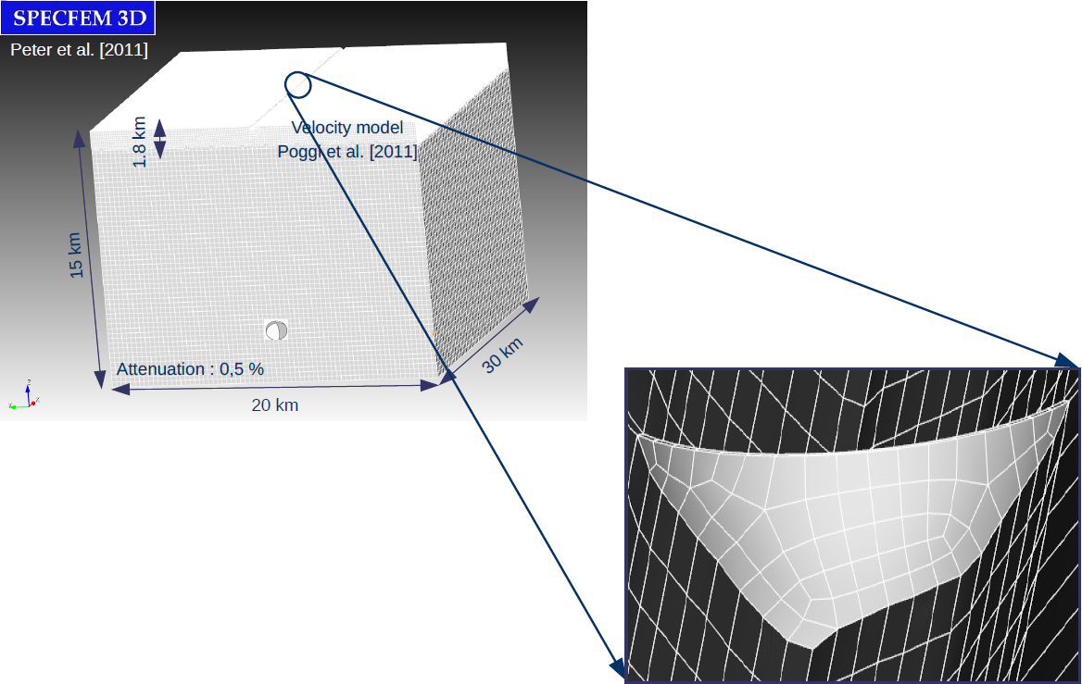
Numerical modelling
11

Slide 12
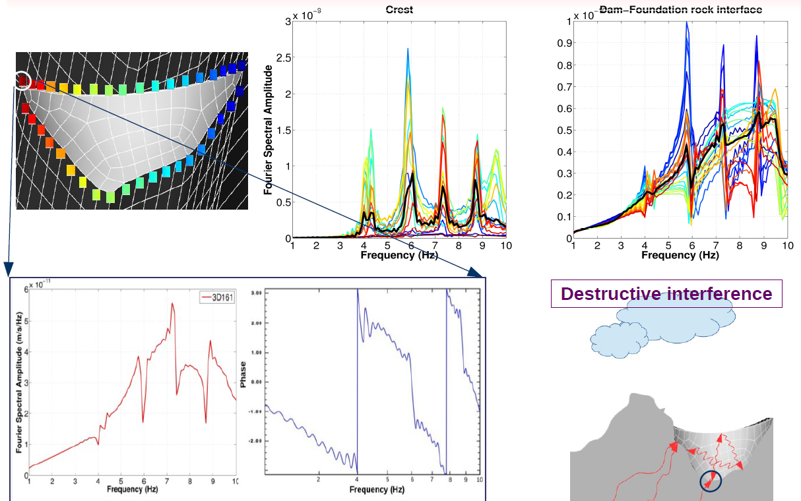
Numerical results
12

Slide 13
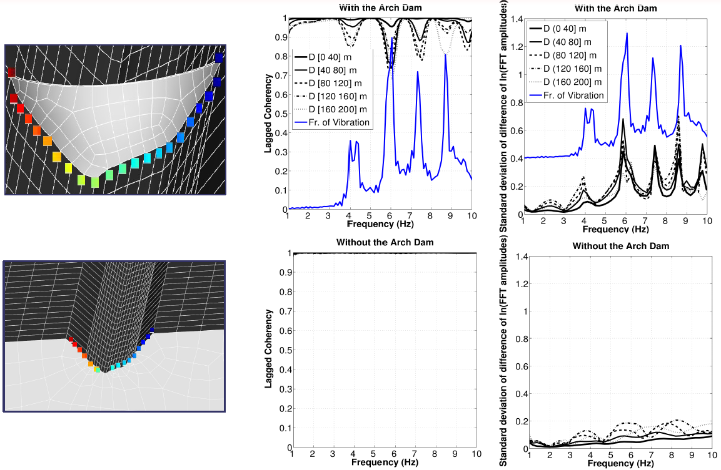
Numerical results: soil structure interaction
13

Slide 14
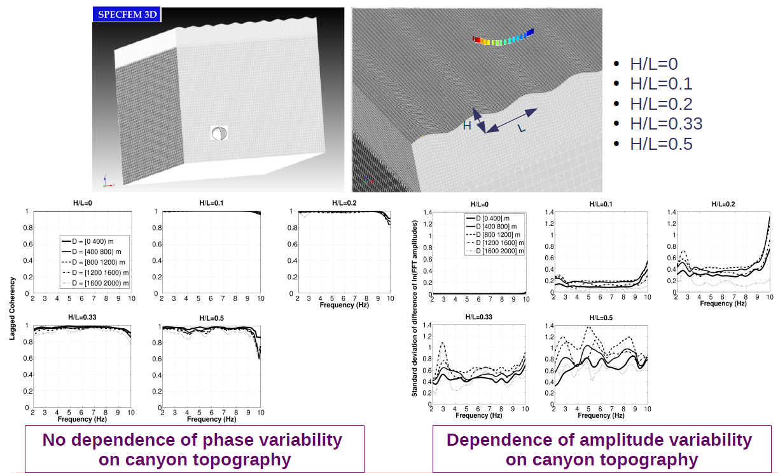
Numerical results: topography effect
14

Slide 15
Conclusions - Perspectives
Seismological Instrumentation of the Saint Guérin site (arch dam and surrounding area)
Seismological database of low to moderate earthquakes
Quantification of spatial variability at the dam-foundation interface
No preferential angle of incidence
Phase and amplitude variability increases with increasing frequency and station separation distance
Higher amplitude variability around the eigenfrequencies of the structure
Slight dependence (2nd order) of variability on soil-structure interaction and canyon topography
⇒ Use of existing variability models in case of arch dams for the design of new and checking of old structures
15

Slide 16
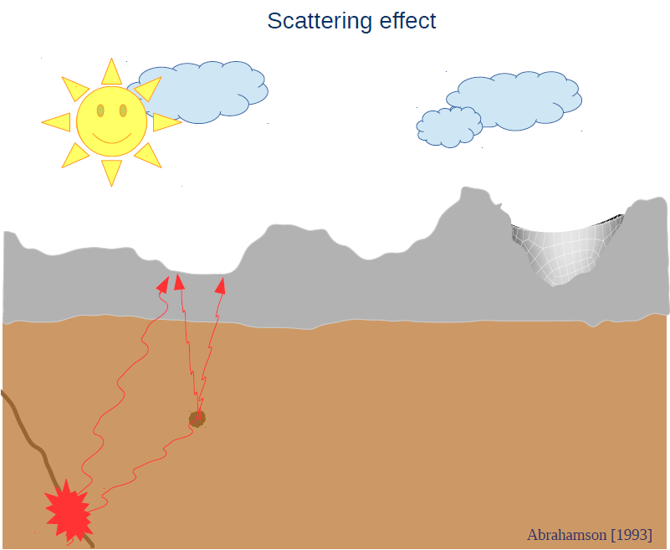
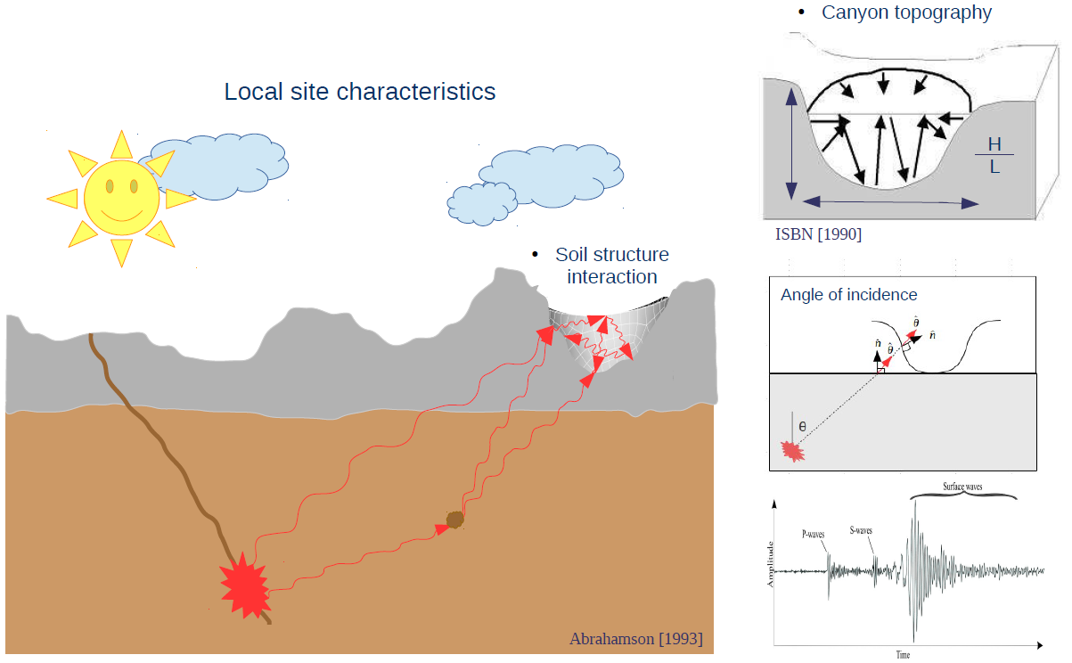
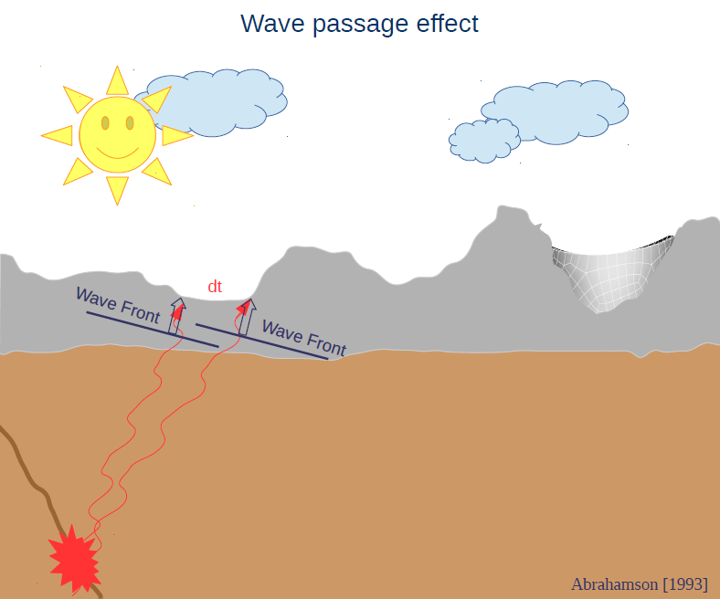
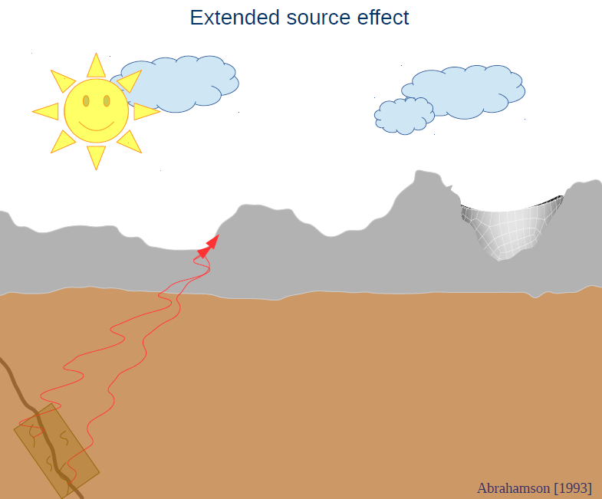
APPENDIX 1: Origins of spatial variability

